Slide 1

Green Pace
Security Policy Presentation
Developer: Ryan Cooper

Slide 2

OVERVIEW: DEFENSE IN DEPTH
By implementing a defense-in-depth strategy, we mitigate the risks associated with single points of failure and enhance overall system resilience.

Slide 3
THREATS MATRIX
Likely: Could happen but has a low severity
Priority: Good chance of happening with a high severity
Low Priority: Low chance of happening and low severity
Unlikely: Low chance of happening but a high severity
Likely ERR-051-CPP FIO-008-CPP | Priority STR-002-CPP MEM-056-CPP EXP-050-CPP EXP-063-CPP
Low priority DCL-004-CPP DCL-052-CPP | Unlikely ERR-006-CPP DCL-058-CPP

Slide 4
10 PRINCIPLES
Validate Input Data | STR-002-CPP, FIO-008-CPP
Heed Compiler Warnings | EXP-063-CPP, MEM-056-CPP, ERR-006-CPP, ERR-051-CPP, DCL-052-CPP
Architect and Design for Security Policies | FIO-008-CPP
Keep It Simple | DCL-004-CPP, EXP-050-CPP, MEM-056-CPP, DCL-058-CPP, DCL-052-CPP
Default Deny | STR-002-CPP
Adhere to the Principle of Least Privilege | FIO-008-CPP
Sanitize Data Sent to Other Systems | STR-002-CPP
Practice Defense in Depth | STR-002-CPP, ERR-006-CPP, ERR-051-CPP
Use Effective Quality Assurance Techniques | EXP-050-CPP, EXP-063-CPP, DCL-052-CPP
Adopt a Secure Coding Standard | DCL-004-CPP, EXP-050-CPP, STR-002-CPP, MEM-056-CPP, ERR-051-CPP, DCL-058-CPP

Slide 5
CODING STANDARDS
STR-002-CPP | Sanitize data passed to complex subsystems like SQL.
MEM-056-CPP | Do not store an already-owned pointer value in an unrelated smart pointer.
EXP-050-CPP | Do not depend on the order of evaluation for side effects.
EXP-063-CPP | Do not rely on the value of a moved-from object.
ERR-006-CPP | Avoid using assert() for program control.
DCL-058-CPP | Avoid undefined behavior by proper namespace usage.
ERR-051-CPP | Catch exceptions with an exception handler.
FIO-008-CPP | Ensure proper file handling by closing files before removing them.
DCL-004-CPP | Do not declare more than one variable per declaration.
DCL-052-CPP | Avoid using const references inappropriately.

Slide 6
ENCRYPTION POLICIES
Encryption at Rest: Encrypt data stored on physical media to protect against unauthorized access.
Encryption in Flight: Encrypt data during transmission to prevent interception.
Encryption in Use: Protect data while being processed to ensure security even when actively manipulated.

Slide 7
TRIPLE-A POLICIES
Authentication: Verify identities before granting access.
Authorization: Define what authenticated users can do.
Accounting: Track and record user activities for monitoring and compliance.

Slide 8
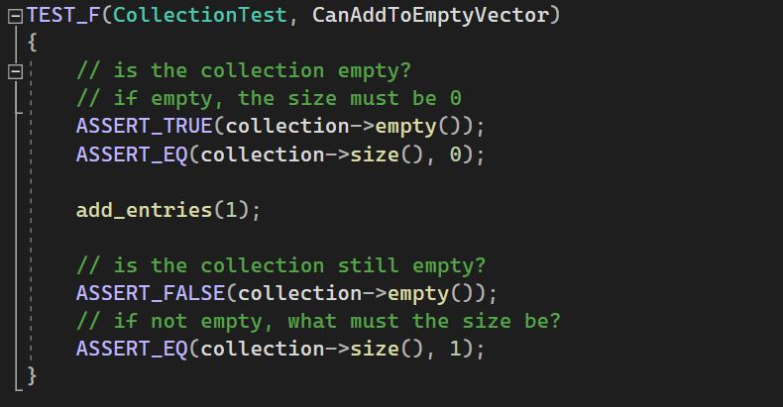
CanAddToEmptyVector

Slide 9
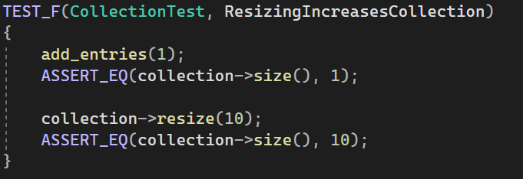
ResizingIncreasesCollection

Slide 10
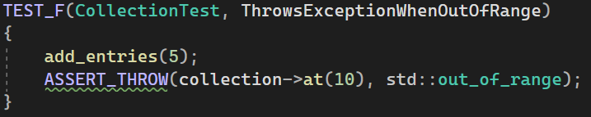
ThrowsExceptionWhenOutOfRange

Slide 11
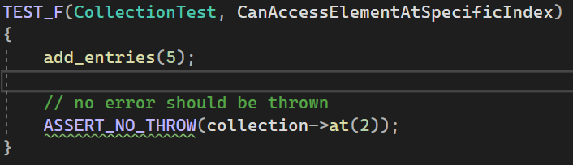
CanAccessElementAtSpecificIndex

Slide 12

AUTOMATION SUMMARY
Automation in the DevSecOps pipeline helps maintain security standards by using security testing tools, automating vulnerability scans, and ensuring consistent enforcement of security policies throughout the development lifecycle.

Slide 13
TOOLS
DevSecOps integrates security practices within the DevOps process, ensuring that security is an integral part of the software development lifecycle from the beginning.
SonarQube: Used for continuous inspection and static analysis, identifying code quality issues and vulnerabilities throughout the coding, build, and test stages.
PVS-Studio: Focuses on detecting bugs and security vulnerabilities during coding and testing, providing detailed analysis and feedback to developers.
Clang-Tidy: Provides static analysis and quality of code during coding, build, and testing stages, ensuring code quality and adherence to standards.

Slide 14
RISKS AND BENEFITS
Security should be implemented now and waiting can lead to attacks on existing weaknesses and the risk of data breaches increases.
Pros
Robust and reliable code
Easier to implement now than later
Cons
Cost Upfront and time needed to implement
Could add complexity to the production and management of the code

Slide 15
RECOMMENDATIONS
Review and update security policies regularly to address emerging threats and ensure that all coding standards are adhered to strictly.
Provide regular training and awareness programs to keep developers informed about the latest security practices and threats.
Foster a culture of security where every team member is responsible for maintaining and improving security.
Conduct regular audits and compliance checks to ensure adherence to security policies and identify areas for improvement.
A security policy only works if every developers follows it!

Slide 16
CONCLUSIONS
Security is just as important as the finished application, so it also needs to be considered from the start.
Sticking to a security policy will hold all developer to the same requirements
Consistency in security practices ensures a robust and resilient application.
Training and awareness programs help keep the team informed and vigilant.
A unified approach to security fosters collaboration and accountability within the team.

Slide 17
REFERENCES
Sei Cert Coding Standards. SEI CERT Coding Standards - CERT Secure Coding - Confluence. (n.d.). https://wiki.sei.cmu.edu/confluence/display/seccode/SEI+CERT+Coding+Standards

